Slide 1
Education and Future Path in Japan
～ Aichi Prefecture Version ～
September, 2024
Aichi International Association

Slide 2
Table of Contents
1. | Future career paths after graduating from Junior High Schools |  | P.2
2. | Available career paths after graduating from Junior High Schools |  | P.3
3. | Academic Pathways after graduating from Junior High Schools |  | P.5
4. | About High School |  | P.6
(1) Differences between P. 6 junior and senior high schools |  | (5) How to choose the High School P.15 most suitable for you
(2) Types of High Schools P. 7 |  | (6) The types of fees for high school P.16
(3) Course of education in P.13 High School |  | (7) Entrance exams for High Schools P.18
(4) Tips for selecting a High School P.14
5. | National Institute of Technology |  | P.27
6. | Vocational Training Schools and College of Technology |  | P.29
7. | Guideline for choosing the future course |  | P.32
8. | What do you need for your future education? |  | P.35
9. | For your future |  | P.37
Additional information 1 Aichi Prefectural Night Junior High Schools |  |  | P.39
Additional information 2 International Baccalaureate Diploma Program |  |  | P.40

Slide 3
１．Future career paths after graduating from Junior High Schools
Lower Secondary School
3 years
Upper Secondary School
3 years
University
4 years
(6 years for some faculties such as medical school)
Graduate School
2 to 5 years
Middle School 3 years
High School
3 years
Flexible High School
Junior
High School
3 years
《Full-time》
Senior High School
3 years
Junior College
2 years
P.8
P.12
《Part-time/Correspondence》
Senior High School
3 years or more
P.9
Colleges of Technology
5 years
Finding a job, etc.
P.27
Vocational School - Advanced Course
(Upper Secondary Specialized Training School)
1-3 years
Vocational School - Specialized Course
(Professional Training College)
1-4 years
P.29
Vocational School - General Course
1 year or more
P.29
Compulsory education ～ age of 15

Slide 4
２．Available career paths after graduating from Junior High Schools
v
① Finding a job
・Look for a job through job hunting.
・A written exam, an interview, etc., are required.
② Go onto higher levels of education
・Study in a high school or a vocational school.
・Some go to school while working.
・Some schools provide online courses.
・A written exam, an interview, etc., are required.

Slide 5
v
In Aichi Prefecture:
＊ Among the junior high school graduates, 98.5% go to high school.
＊ Among high school graduates go to university, 58.2% junior college or vocational school.
（School Basic Survey Report in FY 2023）
v
Reasons to go to a High School or a Vocational School
Number of students finding employment after graduating from junior high school
＝ 1 in 100 students
Japanese companies mostly hire high school, university, or vocational training school graduates.
Most Japanese value the importance of high education to develop knowledge and skills.
Many jobs require high school education as qualification.

Slide 6
３．Academic Pathways after graduating from Junior High Schools
v
（１）Main schools and courses of higher education for Junior High School students in Aichi Prefecture
① Public high school ・Full-time
② Public high school ・Part-time
③ Public high school ・Correspondence
⑤ National high school ・Full-time
⑥ Private high school ・Full-time/Correspondence
⑦ Vocational School
Students may switch back and forth between full-time, part-time, and correspondence courses
④ Public high school ・Flexible high school
・Saya High School (Aisai City)
・Taketoyo High School
(Taketoyo Town)
・Yutakano High School
(Toyota City)
・Mito Aoba High School
(Toyokawa City)

Slide 7
４．About High School
v
（１）Differences between junior and senior high schools
The major difference between junior and senior high school is that grade promotion or graduation is difficult in senior high school.
Junior high school is mandatory education, and there is no dropping out. In high schools, bad grades and/or absentee leads to failure of grade promotion or graduation.
Let’s study seriously to take entrance exams.

Slide 8
v
（２）Types of High Schools 1⃣
Public high school | High schools run by prefectures or cities (Prefectural High School・Municipal High School) Admission and tuition fees are lower than those of private schools
National high school | Government-run research schools affiliated with national universities Admission and tuition fees are lower than those of private schools
Private high school | High schools established by private school corporations Distinctive education policy and curriculum Admission fees, tuition, and other costs are higher than those of public and national high schools.（Subsidies are available）

Slide 9
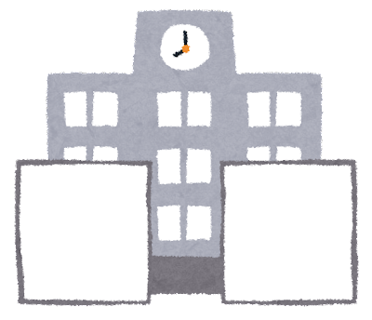
v
（２）Types of High Schools 2⃣
① Full-time
◆ Classes are held during the day on weekdays.
・Go to school in the mornings and attend classeas for 5-6 hours each day.
・Entire class takes the same class at the same time.
Example : A day at a full-time high school

Slide 10
v
② Part-time
◆ Study while working
・Four hours of daily classes in the“daytime” or“evening”
・Take three or more years to graduate
（If study hard, one may be able to graduate in three years.）
Example : A day at a part-time evening high school

Slide 11
v
※An example of time schedule
Part-Time Day Course | Study during the same hours as full-time school （Choice of one of two parts） 1st part：9:00～13:00 2nd part：10:50～15:20
Part-Time Evening Course | 17:00～21:00 School meals provided （Some schools eat school meal before the start of the day, while others eat between classes, and it varies!）
You can learn while working.
You can graduate in 3 years with Day Courses.

Slide 12
v
③ Correspondence
◆ No need to commute to school every day!
・Study at home on your own.
・Go to school on scheduled days.
・Some schools provide online courses.
・Reports are required to be submitted.
・Take three or more years to graduate.
（If study hard, one may be able to graduate in three years.）

Slide 13
v
④ Flexible High School
Students may switch back and forth between full-time, part-time, and correspondence courses.
74 credits are required in order to graduate.
Example : 3 years in a flexible high school
Full-time
Part-time
Correspondence
★First year : Enroll in a correspondence course
★Second year : Take classes in correspondence and part-time courses
★Third year : Take classes in correspondence, part-time, and full-time courses
Period | Mo | Tu | We | Th | Fr
1 |  | C
2 |  | C
3 |  | C
4 |  | C
5 |  | C
6 |  | C
Period | Mo | Tu | We | Th | Fr
1
2 |  | C
3 |  | C |  |  | P
4 |  | C |  |  | P
5 |  | C | P | P
6 |  | C | P | P
Period | Mo | Tu | We | Th | Fr
1
2 |  | C
3 | P | C | P |  | P
4 | P | C | P |  | P
5 |  | F | P | P | F
6 | F |  | P | P
Study at home on non-school days and times

Slide 14
v
（３）Course of education in public high school
General curriculum | Learn the subjects required to pursue higher education General curriculum、Inquiry-based Future Study course、Inquiry-based Regional Study course, etc.
Specialty | Learn practical skills and knowledge Agriculture, industrial technology, commerce, social work, home economics (human life and culture), international relations, etc.
Comprehensive course | Elective course for one's interest

Slide 15
豊田西高校
（４）Tips for selecting a High School
・Decide based on what you want to study and what you like to do.
・Think about what you want to do after graduating from high school.
・Find out about tuition and other fees.
・Visit schools to get feels for the atmosphere.
・Consult with your parents and teachers.
・Ask seniors about their experiences and the school.
・Find out if the school is within commuting distance from home.
... etc.

Slide 16
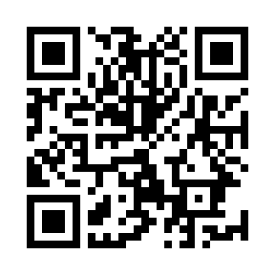
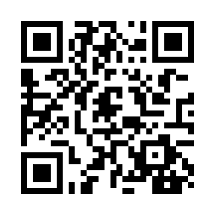
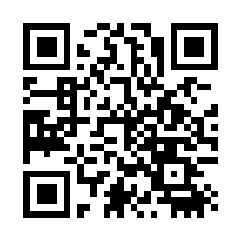
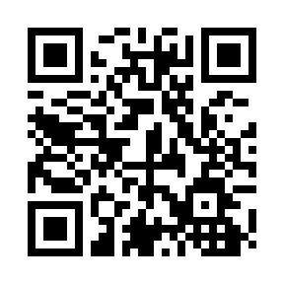
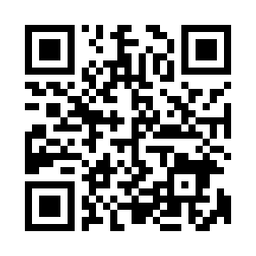
豊田西高校
（５）How to choose the High School most suitable for you
・There are two high schools affiliated with National universities in Aichi Prefecture.
Nagoya University School of Education, affiliated Upper and Lower Secondary Schools
https://highschl.educa.nagoya-u.ac.jp/
Senior High School affiliated to Aichi University of Education
http://www.auehs.aichi-edu.ac.jp/
・Information on Aichi Prefectural high schools can be found at 'Find my! School'.
Aichi Prefectural high school navigation Find my! School
https://aichi-school-navi.aichi-c.ed.jp/
・Information on Nagoya Municipal high schools can be found on the website below.
Website of Nagoya Municipal high schools
https://www.nagoya-c.ed.jp/highschool/
・Information on private high schools in Aichi Prefecture can be found on the website below.
Website of private high schools in Aichi Prefecture
https://www.aichi-shigaku.gr.jp/contents/school.htm

Slide 17
v
（6）The types of fees for high school
Types of fee | Public |  |  | Private
 | Full-time | Part-time | Correspondence | Full-time
Tuition | JPY 118,800/y | JPY 22,800～32,400 /y | JPY 336 per credit | approx. JPY 400,000 /y
Admisshion | JPY 5,650 | JPY 2,100 | JPY 500 | approx. JPY 200,000
PTA membership, student council | approx. JPY 6,000 per month | Day Course: JPY 7,550 /y Evening Course: JPY 4,350 /y (include deposit) | approx. JPY 35,000 /p (School Levies, etc.) | approx. JPY 20,000 /y
School meal | JPY 0 (No school meal) | JPY 5,300 /m (evening course only) | JPY 0 (No school meal) | JPY 0 (No school meal)
Exam fees | JPY 2,200 | JPY 950 | JPY 0 | approx. JPY 14,000
※Examination fee for fiscal year 2025(Reiwa 7) entrance examinations will be announced in November.
※Textbook fees, school trip fees, teaching material fees, uniform fees, and transportation fees will be charged additionally.
★Ref: Website of board of education in Aichi prefecture (As of July 2024), etc

Slide 18
v
Subsidies Available
Apply at the enrolled high school
Subsidies and scholarships | Eligibility | Repayment obligation | Description
High school tuition support fund | National, Public, Private | Not required | Exempt from tuition ※The fund has an upper limit.
Admission Fee Subsidy | Private | Not required | Partial admission fees are subsidized
Tuition Fee Subsidy | Private | Not required | Partial tuition fees are subsidized
Scholarship Fund Loans | National, Public, Private | Required | JPY 11,000 to 35,000 /m
Scholarship for high school student | National, Public, Private | Not required | Finical aid for textbooks and etc. other than tuition

Slide 19
豊田西高校
（7）Entrance exams for High Schools
Is Admission Decided by the Academic Test Alone?
＜Answer＞ It is NOT determined solely based on the test.
School Transcript … The contents of the documents submitted from the junior high school to the high school are “Report Card” and “Student Behavior and Activity”.
Total of grades (5 to 1) for 9 subjects in the report card. ※The highest score is 45.
Grades of junior high school 3rd year
Days attended, club activities, student council activities, etc.
Daily school life is VERY important!
“Punctuality,” “submissions,” and “classroom attitude”will be evaluated.
- 18 -

Slide 20
v
◆ Types of Entrance Examinations for Public High Schools (Full-time)
Types | Characteristics | Applicable Schools
General Selection | Applicants may choose up to two preferred schools. The exam is given once → refer to page 20 | Conducted in all high schools and courses
Recommendation Selection | The selection is made by an overall assessment of a recommendation from the junior high school, an interview, etc. No academic achievement test is conducted. | Conducted in all high schools and courses
Special Selection | The selection focuses on willingness to learn and ability and achievement in areas related to the course. | Some schools have the selection
Selection for Foreign Students, etc. | The applicant or the guardian must be a foreign national and the period of stay in Japan after entry must be less than 6 years, etc. → refer to page 21 | Some schools have the selection (12 schools have the selection in 2025)
Full-time Credit System Selection | Applies to students who have approximately 30 days of absences per year in either the second or third year or both in their respective grades of junior high schools. | Full-time and credit-based high schools have the selection (Including full-time flexible high schools)
Returned Overseas Students | Applies to students who have resided abroad with their guardians for 2 or more consecutive years and within 2 years of returning to Japan. | Some schools have the selection

Slide 21
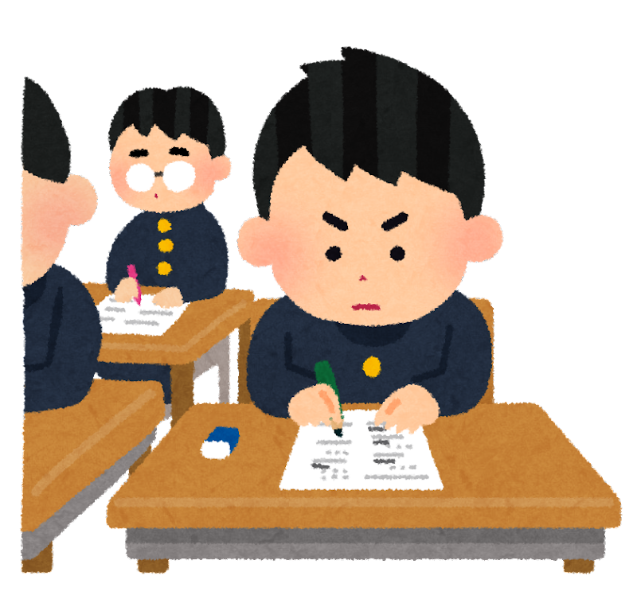
v
◆ Public High Schools ・ General selection for Full-time courses
○ One can apply for up to 2 schools.
○ Subjects for examination:
5 subjects including Japanese, Math, Social studies, Science, and English
English test includes a listening comprehension test.
Some high schools conduct interviews and some do not.
○ Date of the entrance exam:
Wednesday, February 26th, 2025
(The exam is given once even if applicants apply to 2 schools.)

Slide 22
v
※See p. 23 for Flexible High Schools
◆ Public High Schools ・ Entrance exams for Part-time courses
Types | Characteristics | Contents of exams
Selection of entrants | Applicants may not apply to full-time courses. | An interview (some schools require a basic academic skills exam and an essay)
Second selection | Conducted when the number of applicants is not enough.
◆ Public High Schools ・ Entrance exams for Correspondence courses
（Kyokuryo High School・Kariya Higashi High School）
Types | Characteristics | Contents of exams
First selection | Applicants may not apply to full-time or part-time courses. | Successful applicants are chosen by a school transcript and a personal statement. If needed, an essay and an interview may be conducted.
Second selection | Applicants may apply to after receiving the results of full-time or part-time courses.

Slide 23
v
◆ Selective examination for foreign students etc. at public high school
Eligibility | Foreign national students who are the residents of Aichi Prefecture with their guardians and have transferred to a Japanese elementary school as fourth grade or above (Must be less than 6 years after entering Japan)
Subjects for Examination | ・An academic test with Hiragana that includes Japanese, Mathematics and English ・Interview
Date of the exam | Thursday, February 6th, 2025
Applicable Schools | Nagoya Minami High School, Komaki High School, Higashiura High School, Koromodai High School, Anjo Minami High School, Mito Aoba High School, Toyota High School of Technology, Toyokawa Toyota High School of Technology, Iwakura Sogo High School, Nakagawa Seiwa High School, Chiryu High School, Toyohashi Nishi High School

Slide 24
v
◆ Types of entrance exams for Flexible High Schools
Types | Contents of exams
Full-time Credit System （Special Selection） | Conduct an interview. Choose one from an essay, a basic academic skills exam, and a presentation.
Part-time Day Course | Conduct an interview. One or both of an essay and a basic academic skills exam.
Correspondence | One, two, all, or none of the following : an interview, an essay, and a basic academic skills exam..
● Changing courses and taking classes in different courses are not allowed in the middle of the school years (terms). Please choose courses carefully.
Flexible High School??

Slide 25
v
◆ Entrance exam schedule of Public High Schools (image)
Types | 1／15 2／1 2／15 3／1 3／15 3／31
Full-time course General selection
Selective examination for foreign students etc.
Part-time course Selection of entrants
Correspondence course Selection of entrants First selection
Correspondence course Selection of entrants Second selection
Application period
Exam and interview
Announcement of the successful applicants

Slide 26
・名古屋大学教育学部付属高等学校
◆ Types of entrance exams for National High Schools
● Nagoya University School of Education, affiliated Upper and Lower Secondary Schools (Academic year 2024)
Types | Characteristics | Contents of exams
General Selection | Conduct an academic achievement exam, an essay, and a group interview. Subjects that do not require exams are screened by a school transcript. | Japanese, English, Math, Essay, A group interview
Returned Overseas Students | Applies to students who have resided abroad for 2 years or more and within 2 years of returning to Japan. A school transcript, personal information, and a certificate of residence abroad are required. | Japanese, English, Math, Essay, An individual interview
Special Recommendation Selection | Applies to students with outstanding grades and personalities. A school transcript, a recommendation from the principal of the junior high school, and a personal statement are required. | A document screening (a school transcript, a recommendation from the principal of the junior high school, and a personal statement) and an individual interview
● Senior High School affiliated to Aichi University of Education (Academic year 2024)
Types | Characteristics | Contents of exams
General Selection | No interview is conducted. | Japanese, Math, English, Science, Social studies
Returned Overseas Students | Applies to students who have resided abroad for 2 years or more and within 2 years of returning to Japan. A school transcript is required. | Japanese, Math, English, Science, Social studies, An individual interview
Recommendation Selection | Applies to students with outstanding personalities and academic abilities or students with outstanding abilities, aptitudes, and achievements in athletics, culture, special activities, etc. | Essay, An individual interview

Slide 27
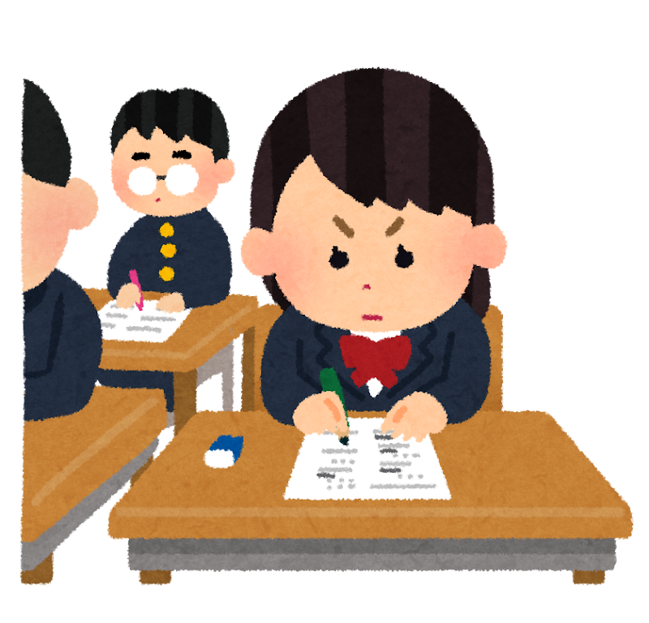
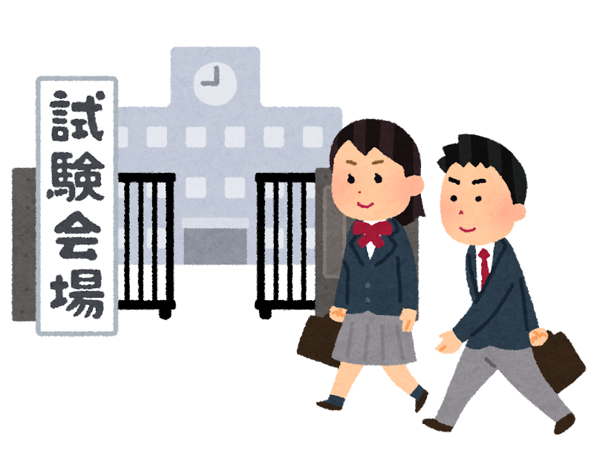
＊試験内容 は学校 によって異 なる
◆ Types of entrance exams for Private High Schools
Types | Characteristics | Contents of exams
General Selection | Applicants may apply to up to 3 schools with different exam dates. Applicants may apply to both private and public high schools. | Achievement exams (3 or 5 subjects, etc) Some schools conduct a practical skills exam.
Recommendation Selection | A recommendation from the principal of the junior high school is required. Applicants must enroll if accepted. | An interview, an essay, etc. Basic academic skills exams (3 subjects of English, Math, Japanese, etc.)
Special Selection | A self-recommendation type that does not require a recommendation from the principal of the junior high school. A school transcript is required. Applicants must enroll if accepted. | An interview, an essay, etc. Basic academic skills exams (3 subjects of English, Math, Japanese, etc.)
＊Contents of exams vary depending on schools

Slide 28
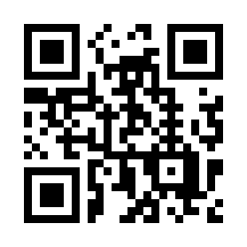
5．National Institute of Technology
◆ What is National Institute of Technology?
The school is a combination of a high school and a college, aiming to train engineers with practical knowledge. 5-year course.
Actively conduct classes, experiments, and practical training in specialized subjects from the first year.
● National institute of technology in Aichi Prefecture
National Institute of Technology, Toyota College
https://www.toyota-ct.ac.jp/
It has a Department of Mechanical Engineering, a Department of Electrical and Electronic Engineering, a Department of Information and Computer Engineering, a Department of Civil Engineering, and a Department of Architecture.

Slide 29
◆ Types of entrance exams for National Institute of Technology, Toyota College
Types | Characteristics | Contents of exams
Achievement exam selection | Applicants may apply to up to the third department of their choice. | 5 subjects including Japanese, Social studies, Math, Science, and English
Recommendation Selection | Conducted only in the department of the first choice. A school transcript and a recommendation from the principal of the junior high school are required. | Interview
● Applicants must enroll if accepted.
● Applicants may take public high school entrance exams if not accepted.

Slide 30
6．Vocational Schools and Colleges of Technology
〈Vocational Schools〉
Purpose
Develop skills and knowledge required for careers and daily life
School Subjects
Household Management, Social Work, Fashion, Industrial Technology, Hair Stylists, Nutritionist, Commerce, Computer Design, etc.
Obtain certifications and/or licenses (Caregiver, Hazardous Materials Officer, Electrician, Chef License)
Feature ①
Feature ②
Allows obtaining high school diploma in some schools

Slide 31
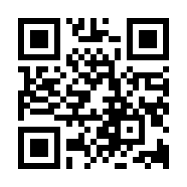
)
豊田西高校
Let's check out Vocational Schools!
Website introducing vocational schools in Aichi Prefecture.
https://www.askr.or.jp/search/
・Vocational schools in Aichi Prefecture can be searched by the fields of studies and the names of schools.
・Schools that offer trial enrollment are listed.
・Admission requirements (contents of exams, exam dates, etc.) can be found.

Slide 32
〈Colleges of Technology〉
・Provides vocational training for technical workers
・Schools for students who want to pursue career in architecture, landscaping and electrical field
・Exam Subjects: Japanese, Math, Interview
・How to Apply：Submit documents to the public employment security office (Hello Work)
・Note : Graduating from colleges of technology does not mean to gain academic background as it is different from regular high schools and universities.

Slide 33
7．Guideline for choosing the future course
【1st year in junior high school】
◆ Occupational interview: Learn about occupation
Learn about the meaning of work from people around you.
⇒ Learn about different careers.

Slide 34
【2nd year in junior high school 】
◆ Work experience activity
Work experience at local company, hospitals and welfare facility. Learn enjoyment by interacting with other people while working.
⇒ Find a hint for your future course.

Slide 35
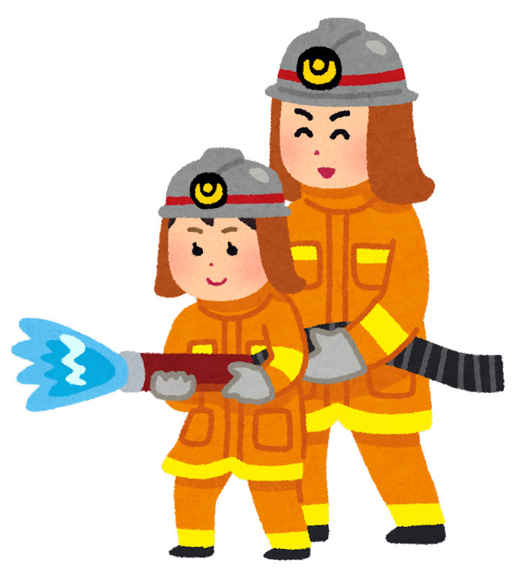
【3rd year in junior high school】
◆ Work experience activities on school trip： Visit Tokyo, the capital of Japan and see different professions and interview people who work there.
◆ Future course after graduation： Think about the future and way of living in order to decide your future course.
⇒ Aim self-actualization

Slide 36
8．What do you need for your future education?
① Dream, Goal!
Why and what do you want to learn.
What do you want to do in your future in Japan.
Find something you want to do.
② Japanese language & academic skills!
Make effort to use Japanese!
Do your best in e effort to class.

Slide 37
③ Ability to adjust to school life
・Be punctual.
・Greet others in a pleasant manner.
・Dress and use language appropriate to the occasion.
・Follow the rules.

Slide 38
9．For your future
◆ Learn when you can, and learn well!
◆ Consult with your school teachers.
◆ When deciding on a career path, consult with your family.
◆ Go to school tours. (school open house, etc.)
◆ Never give up!
Let me repeat them because they are very important.

Slide 39
Will support your dream! Smile and move forward!
Hang in there!

Slide 40
Additional information 1
Aichi Prefectural Night Junior High Schools
・Go to school from around 17:00 to 21:00
・4 classes a day (one class : 40 minutes)
・Graduate in 3 years (Possible to shorten or extend up to 6 years)
Example : A day at a Prefectural night junior high school

Slide 41
Additional information 2
International Baccalaureate Diploma Program
International educational program offered by International Baccalaureate Organization.
Upon completion of the course and passing the examination, students may obtain the International Baccalaureate Diploma.
It is an internationally recognized university entrance qualification.
Few schools offer Japanese high school diplomas.3
・Classes are normally taught in English.
・Some schools have admission periods in September.
・It has required and elective courses.

Slide 42
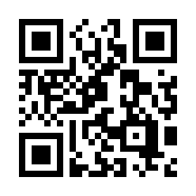
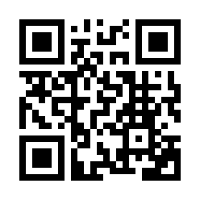
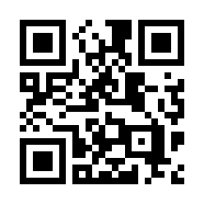
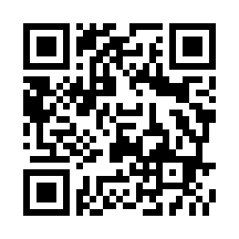
Schools offer International Baccalaureate Diploma Program in Aichi Prefecture
＜Schools offering high school diplomas＞
・“Kokusai Koto Gakko” NUCB International College (NIC)
・“ Nagoya Kokusai Koto Gakko” NUCB International Senior High School
※NUCB:Nagoya University of Commerce and Business
＜ International Schools＞
・Enishi International School
・Nagoya International School
https://ic.nucba.ac.jp/jp/
https://www.nihs.ed.jp/
https://enishi.ac.jp/JP/
https://www.nis.ac.jp/japanese/welcome

