Slide 1
English
Education Guidance
for Children
and Guardians with Foreign Backgrounds
In Ama City
Interpretation is available in Vietnamese, Portuguese, Spanish, English, Chinese,
and Filipino/Tagalog.
Feel free to consult us, if you have any concerns about your future course, school life, learning Japanese language, educational expenses and more!
【When】
August 5th, 2023 (Saturday) 13：00～15：30
【Where】
Ama city office Conference Room D
（1banchi Shippo-cho Okinoshima Fukatsubo, Ama City）
【Subject】
Junior high school students with foreign backgrounds
and their guardians, 20 families
【Contents】
Japanese education system, preparation for future education course to high school, story of senior
experiences and so on.
【How to apply】
Fill out the application form on the backside
and send it by FAX or e-mail
【Deadline for application】
Register by July 25th (Tuesday)
Hosted by Ama City・Ama Board Of Education・Aichi International Association

Slide 2
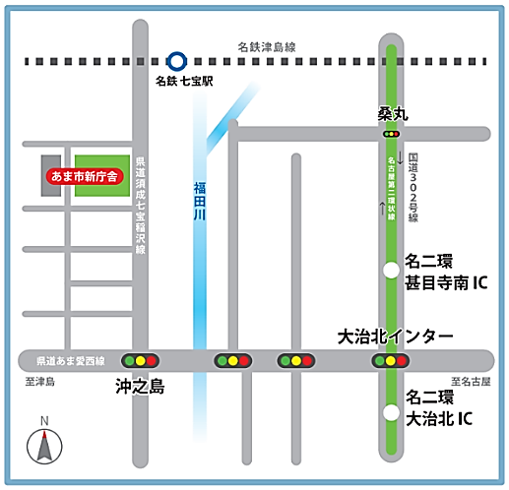
【Access】
Ama city office
Address: 1banchi Shippo-cho
Okinoshima Fukatsubo, Ama City
Access: 15-minute walk from Meitetsu
”Shippo” station.
＊Please park at Ama city office parking lots
if you are coming by car.
【Application・Contact】
Aichi International Association
E-mail : kikin@aia.pref.aichi.jp
TEL Japanese 052-961-8746
Other languages 052-961-7902
FAX : 052-961-8045
Address 2-6-1,Sannnomaru, Naka-ward, Nagoya City.
【Application Form】
▼Provided personal information below will be kept confidential and only be used for operation purposes. We will not disclose your personal information to any third parties without your consent. We will contact you after receiving the applications. Please contact us in case you didn't receive a response within a week.
Name (Guardians or Representative) | Nationality | Need an Interpreter?
 |  | □ Yes：Language（ ） □ No
 |  | □ Yes：Language（ ） □ No
Contact（We will reach you in casesomething happens） | TEL： E-mail：
Name（Children） | Name of school | Grade / Age | Need an Interpreter? | Other
 | Chugakko | / | □ Yes：Language （ ） □ No | When did you come to Japan? （ year month）
 | Chugakko | / | □ Yes：Language（ ） □ No | When did you come to Japan? （ year month）
▼You can register from
QR code.
Please write any questions or concerns.

